Slide 1

Worms and Stochastic Epidemic Models supervised by Dr. Chak Hei (Hugo) Lo
Department of Statistical Science
Faculty of Mathematical & Physical Sciences
Notes:
Hello, everyone!
My project is “Worms and Stochastic Epidemic Models”. And I am supervised by Dr. Hugo Lo.

Slide 2
Background
Nowadays, worms family is one of the most aggressive and dominant type of computer viruses.
They can spread through computer networks without any human intervention.
The modern world is becoming increasingly mobile.
Wide adoption of short-range wireless communication technologies like WLAN and Bluetooth.
They provide lots of convenience for worms to get more devices infected when people carried infected devices are moving.

Slide 3
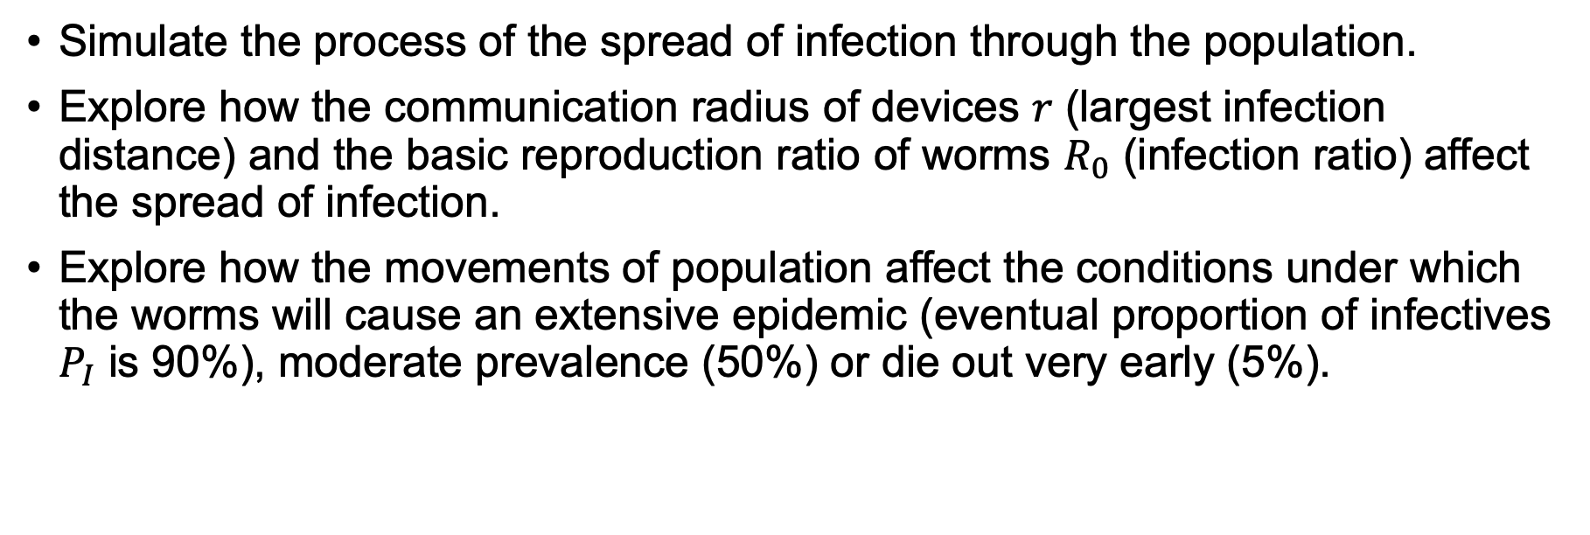
Objectives
Simulate the process of the spread of infection through the population.
Explore how the communication radius of devices $r$ (largest infection distance) and the basic reproduction ratio of worms $R_{0}$ (infection ratio) affect the spread of infection.
Explore how the movements of population affect the conditions under which the worms will cause an extensive epidemic (eventual proportion of infectives $P_{I}$ is 90%), moderate prevalence (50%) or die out very early (5%).

Slide 4
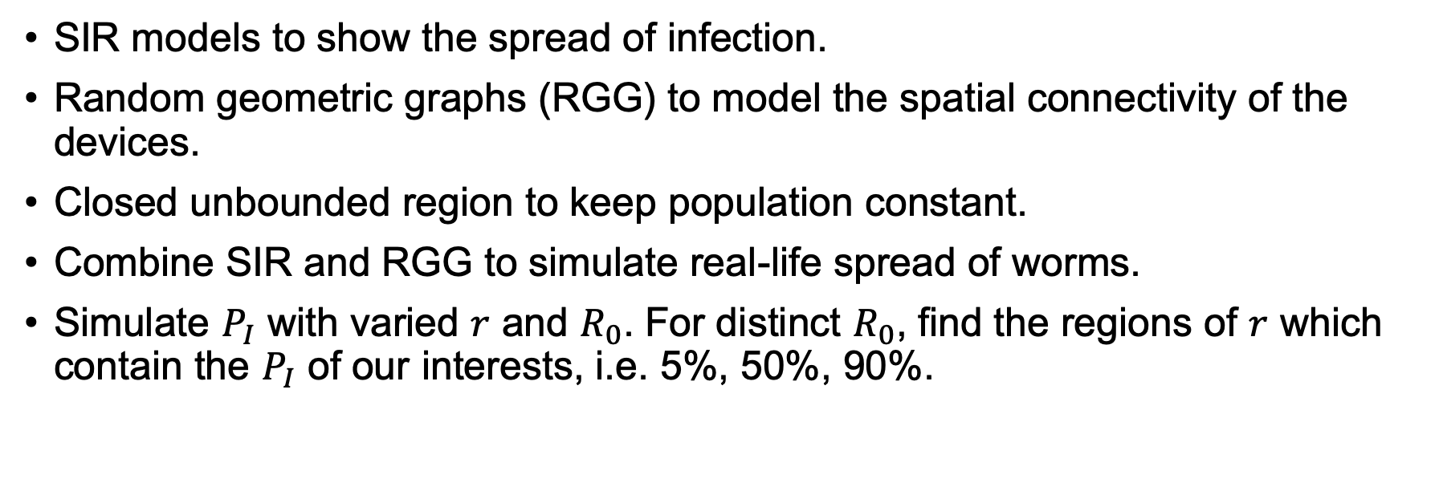
Methodology
SIR models to show the spread of infection.
Random geometric graphs (RGG) to model the spatial connectivity of the devices.
Closed unbounded region to keep population constant.
Combine SIR and RGG to simulate real-life spread of worms.
Simulate $P_{I}$ with varied $r$ and $R_{0}$. For distinct $R_{0}$, find the regions of $r$ which contain the $P_{I}$ of our interests, i.e. 5%, 50%, 90%.

Slide 5
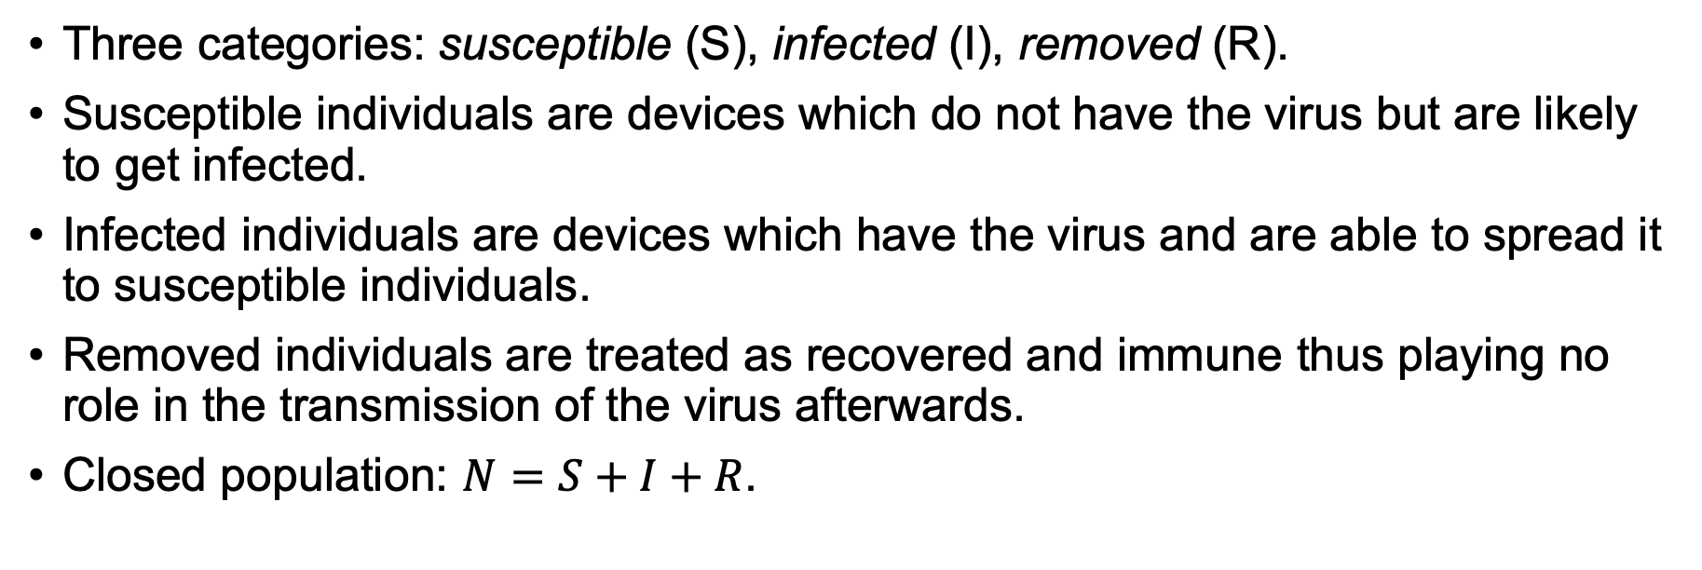
SIR Model
Three categories: susceptible (S), infected (I), removed (R).
Susceptible individuals are devices which do not have the virus but are likely to get infected.
Infected individuals are devices which have the virus and are able to spread it to susceptible individuals.
Removed individuals are treated as recovered and immune thus playing no role in the transmission of the virus afterwards.
Closed population: $N=S+I+R$.

Slide 6
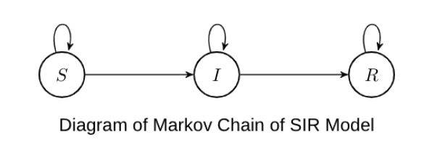
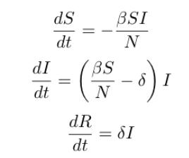
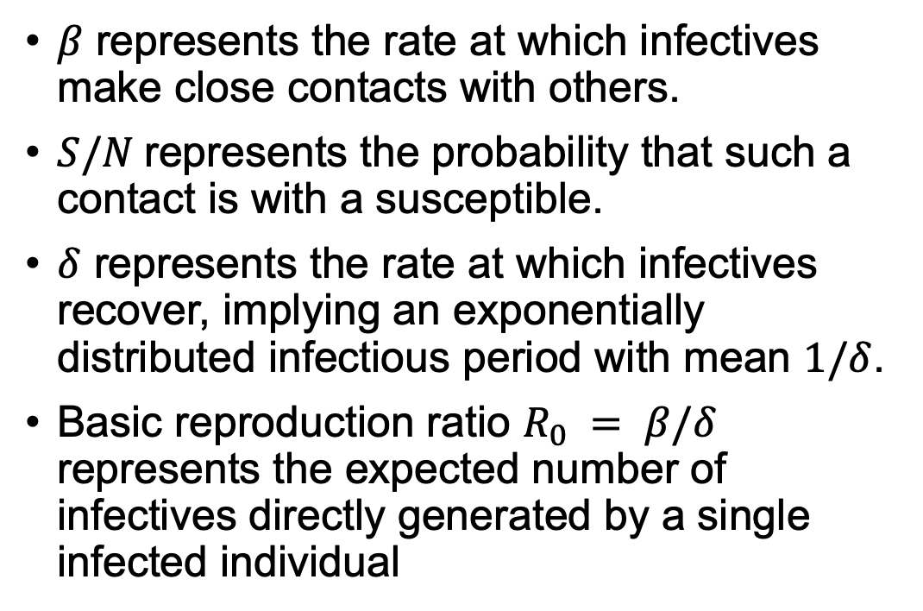
SIR Model
$β$ represents the rate at which infectives make close contacts with others.
$S/N$represents the probability that such a contact is with a susceptible.
$δ$ represents the rate at which infectives recover, implying an exponentially distributed infectious period with mean $1/δ$.
Basic reproduction ratio $R_{0} = β/δ$ represents the expected number of infectives directly generated by a single infected individual

Slide 7
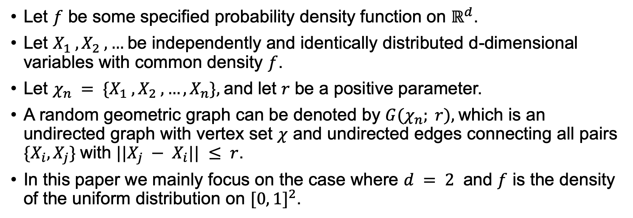
Random Geometric Graphs
Let $f$ be some specified probability density function on $ℝ^{d}$.
Let $X_{1} , X_{2} , …$be independently and identically distributed d-dimensional variables with common density $f$.
Let $χ_{n} = \{X_{1} , X_{2} , …, X_{n}\},$and let $r$ be a positive parameter.
A random geometric graph can be denoted by $G(χ_{n}; r),$which is an undirected graph with vertex set $χ$ and undirected edges connecting all pairs $\{X_{i},X_{j}\}$with $||X_{j} − X_{i}|| ≤ r$.
In this paper we mainly focus on the case where $d = 2$ and $f$ is the density of the uniform distribution on ${[0, 1]}^{2}$.

Slide 8
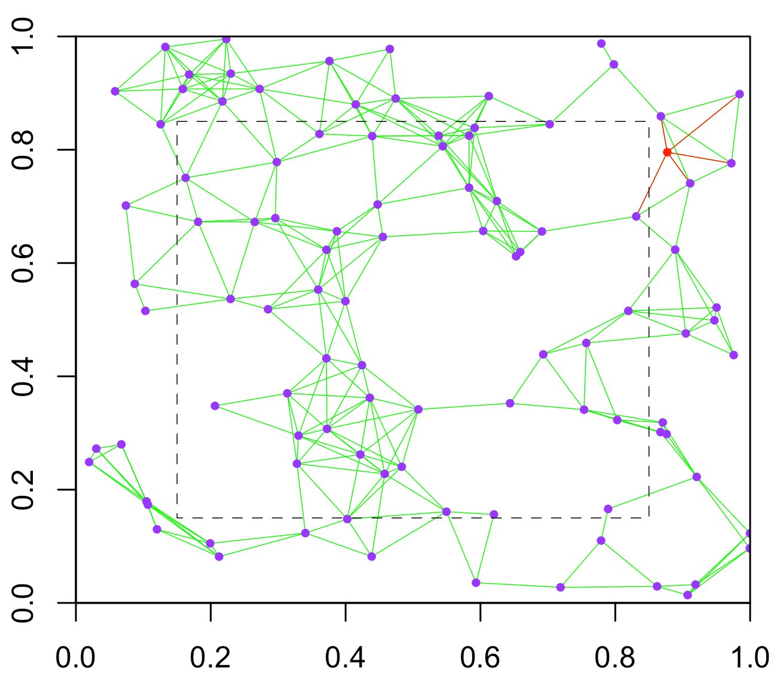
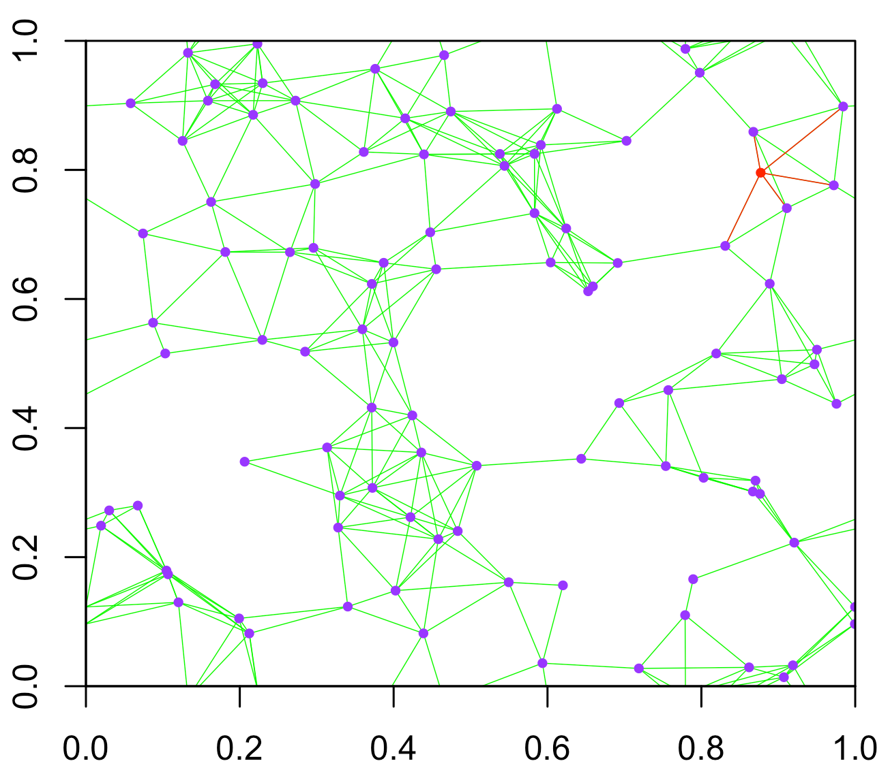
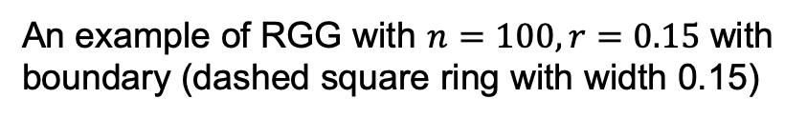
Random Geometric Graphs without boundary
An example of RGG with $n=100, r=0.15$ with boundary (dashed square ring with width 0.15)
An example of RGG without boundary

Slide 9
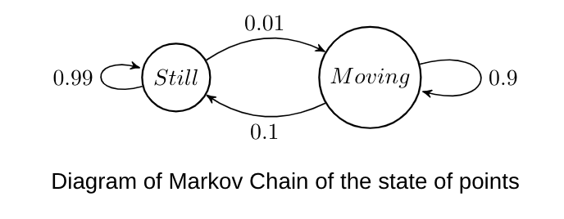
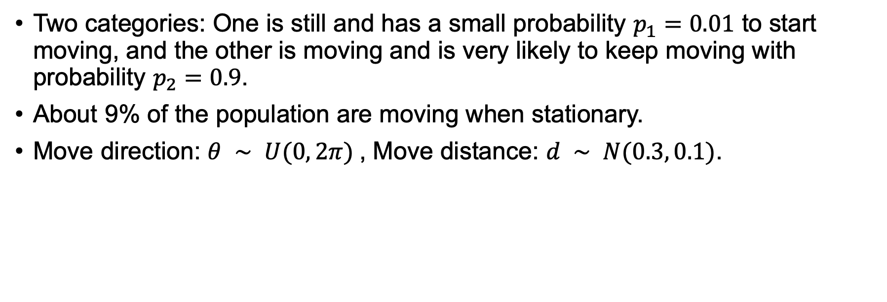
Movements of the population
Two categories: One is still and has a small probability $p_{1}=0.01$ to start moving, and the other is moving and is very likely to keep moving with probability $p_{2}=0.9$.
About 9% of the population are moving when stationary.
Move direction: $θ ∼ U(0, 2π)$, Move distance: $d ∼ N(0.3, 0.1)$.

Slide 10
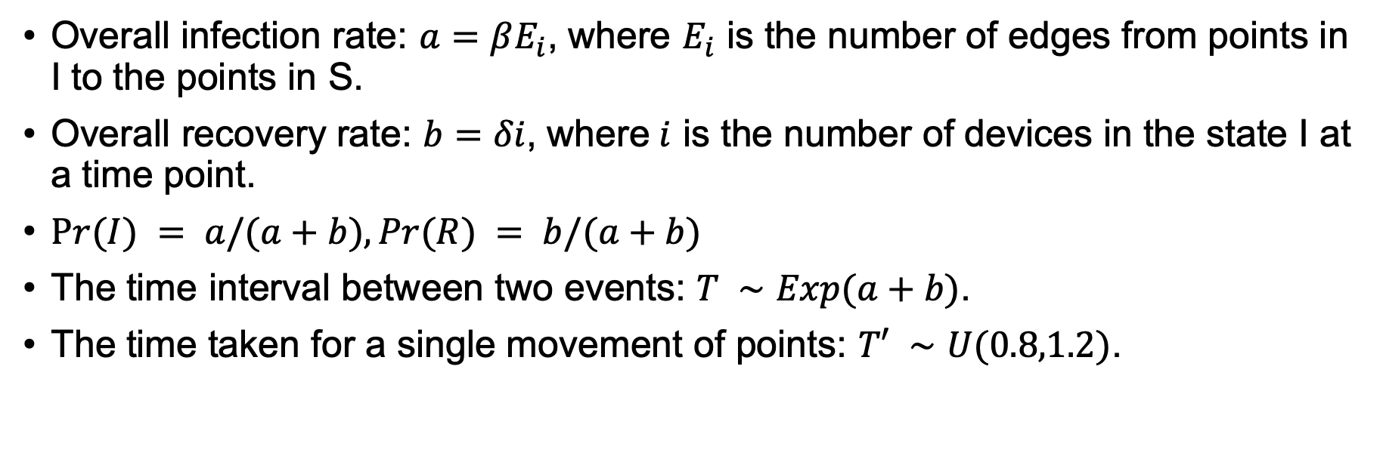
Movements of the population
Overall infection rate: $a=βE_{i}$, where $E_{i}$ is the number of edges from points in I to the points in S.
Overall recovery rate: $b=δi$, where$i$ is the number of devices in the state I at a time point.
$Pr⁡(I) = a/(a+b), Pr⁡(R) = b/(a+b)$
The time interval between two events: $T ∼Exp(a+b)$.
The time taken for a single movement of points: $T′ ∼U(0.8,1.2)$.

Slide 11
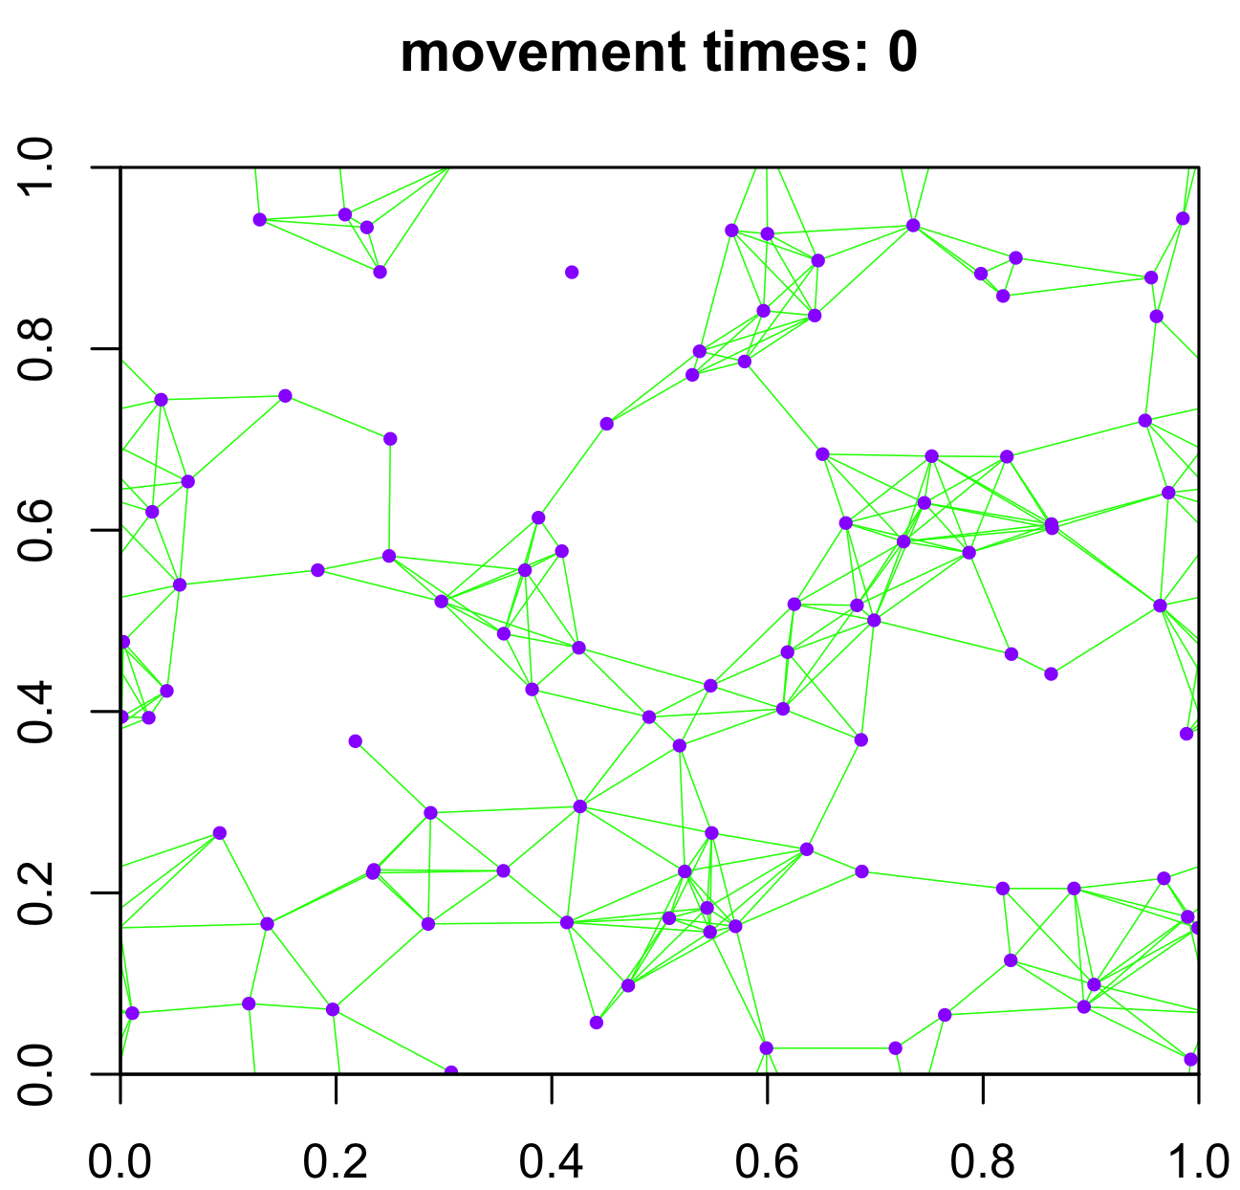
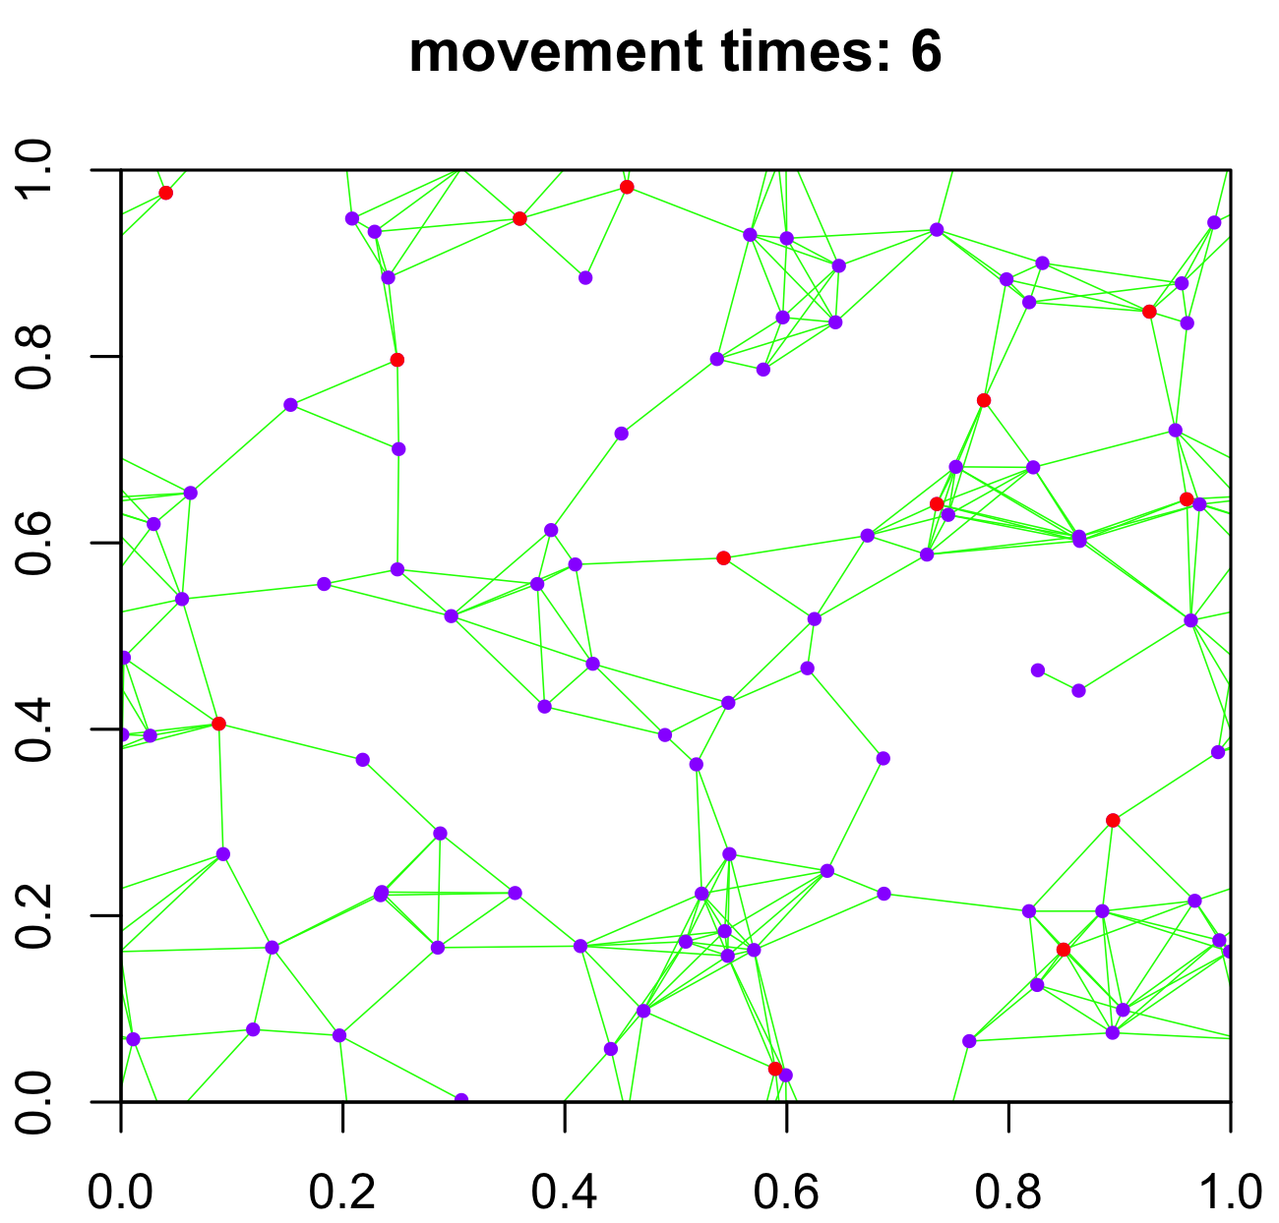
Movements of the population
Distribution of points before movements (No event has happend)
Animation showing the movements until the first event
Distribution of points after movements (just before the first event occurs)

Slide 12
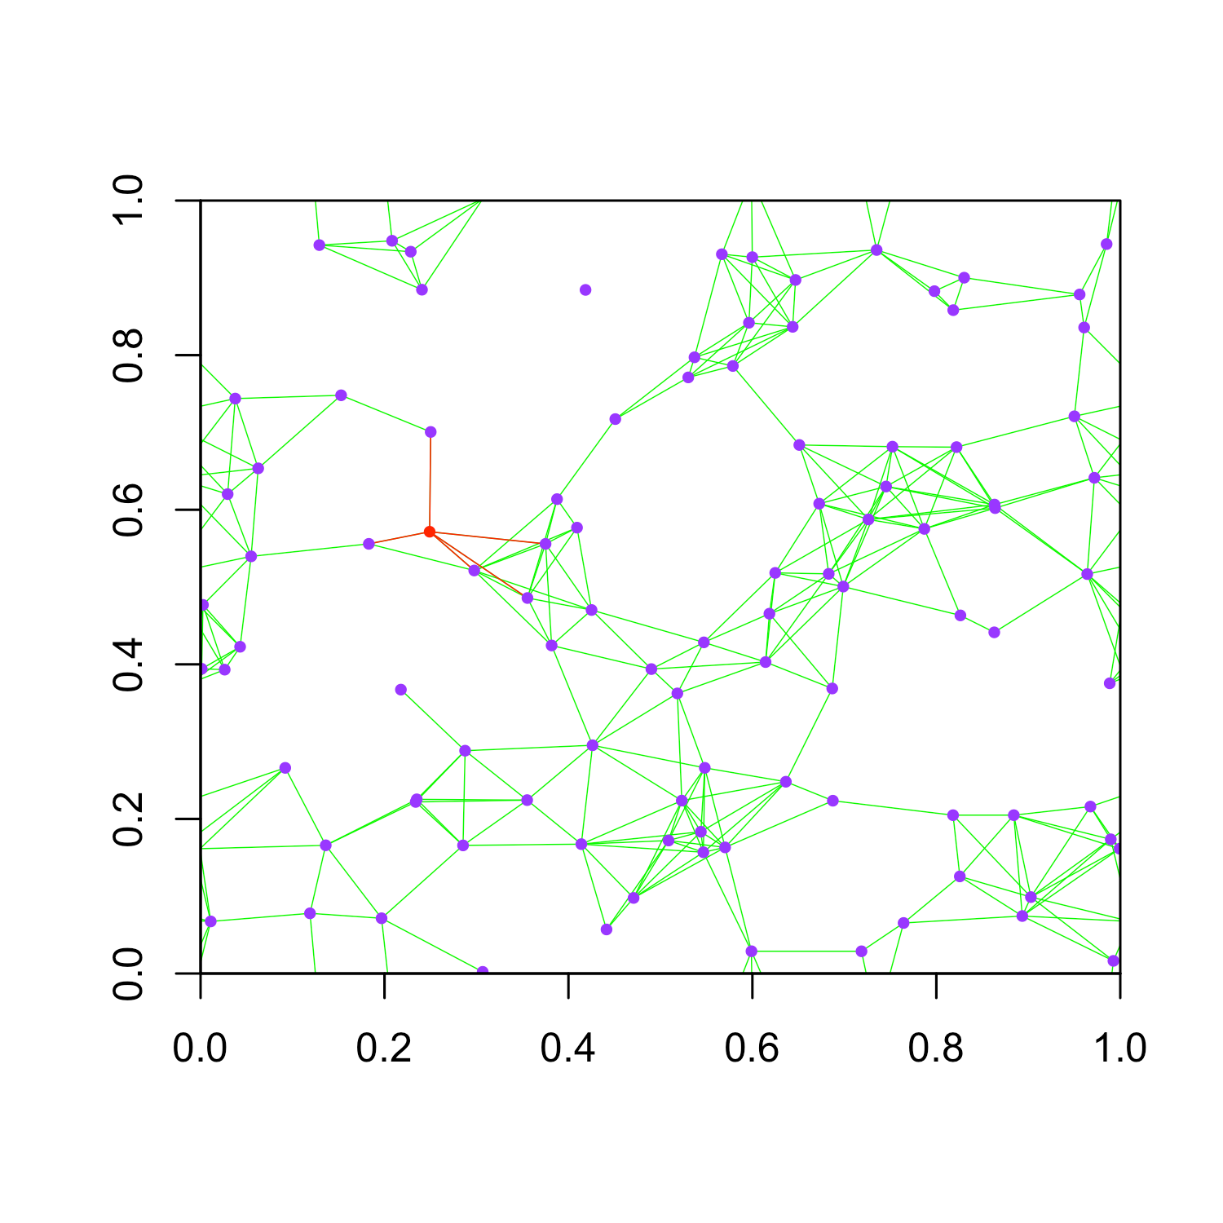
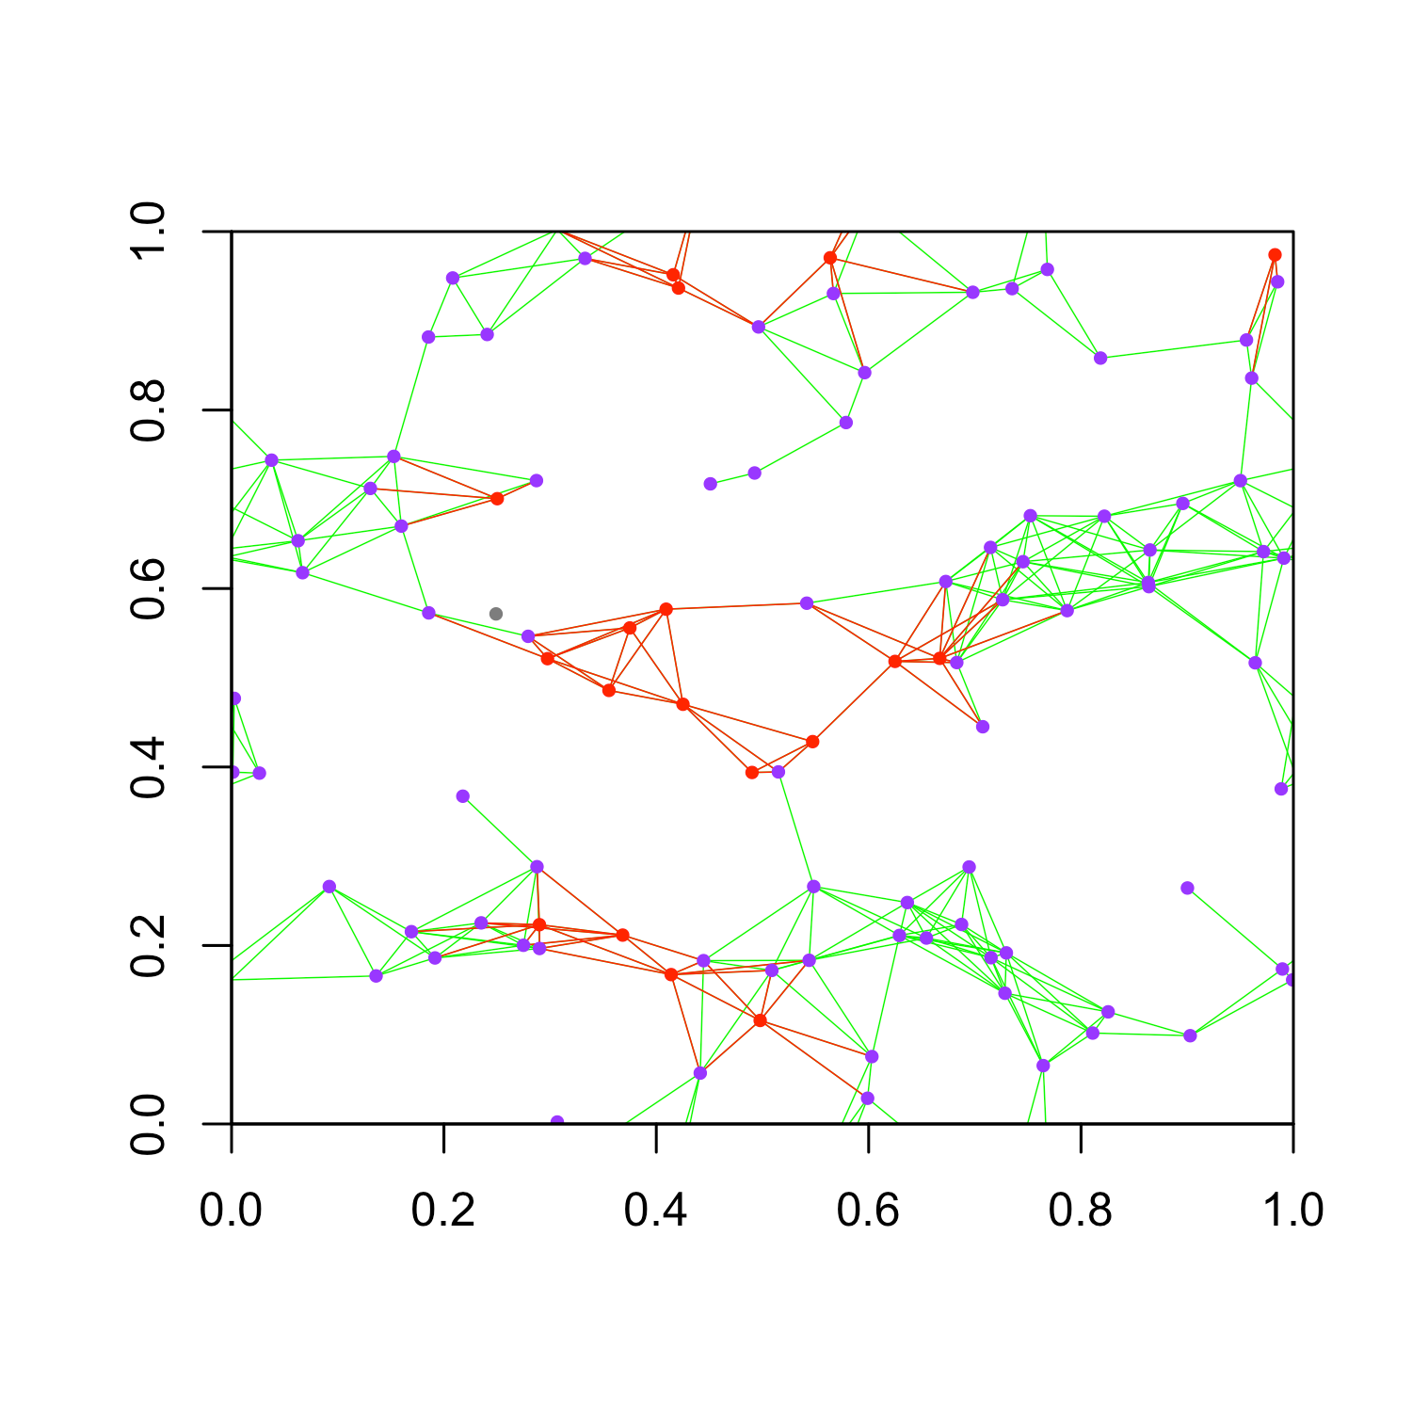
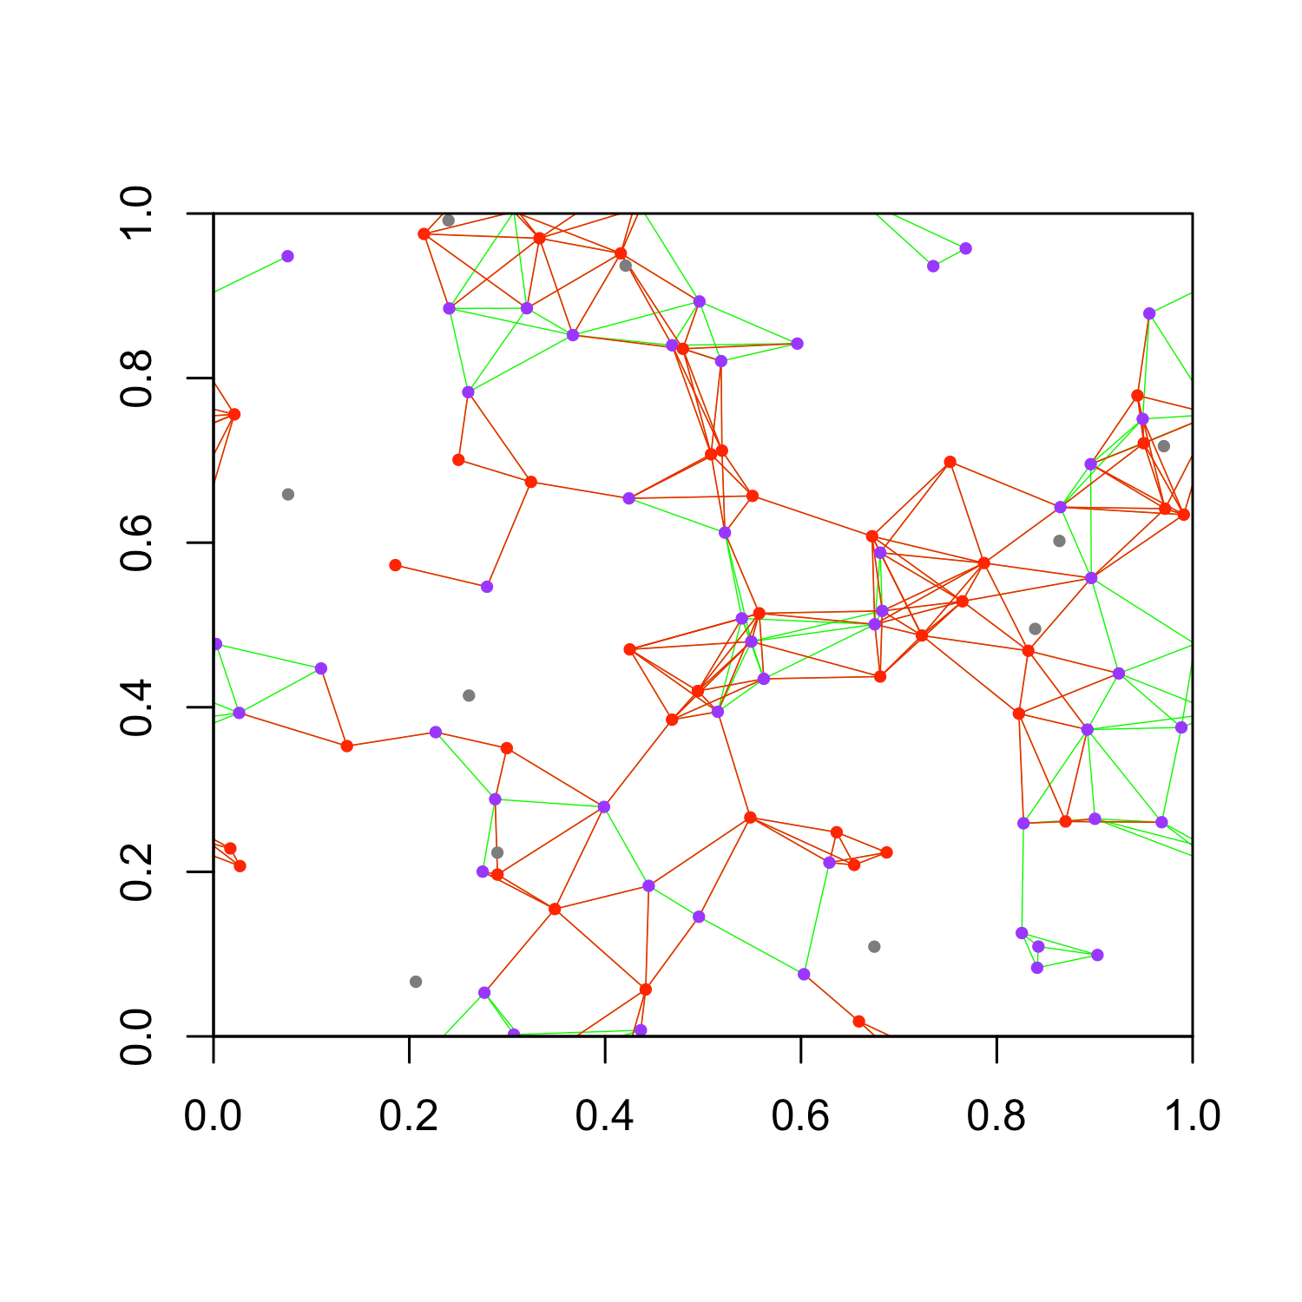
Transmission of Virus
times = 0: initial state with only one infective
times = 19: the first recovery event occurs
times = 59: 50% of the population get infected

Slide 13
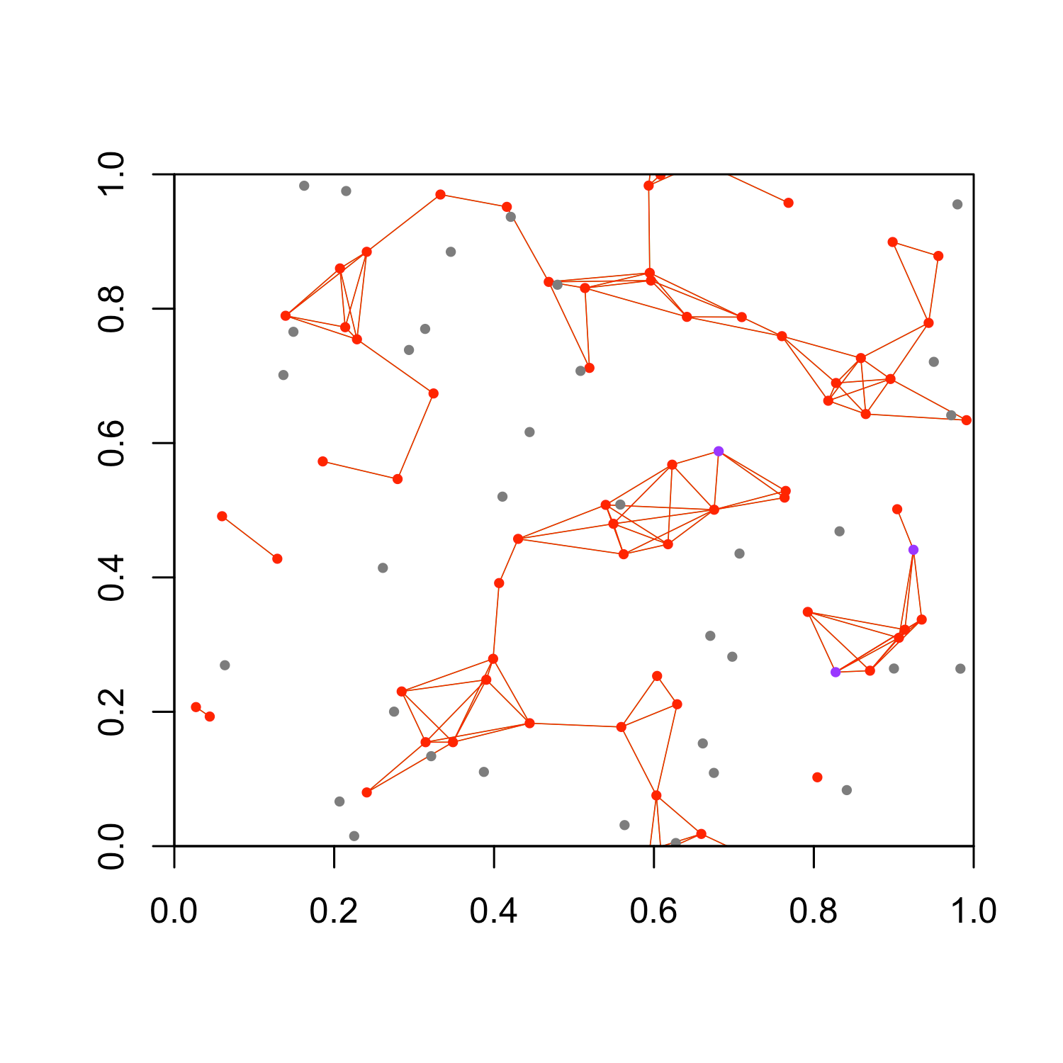
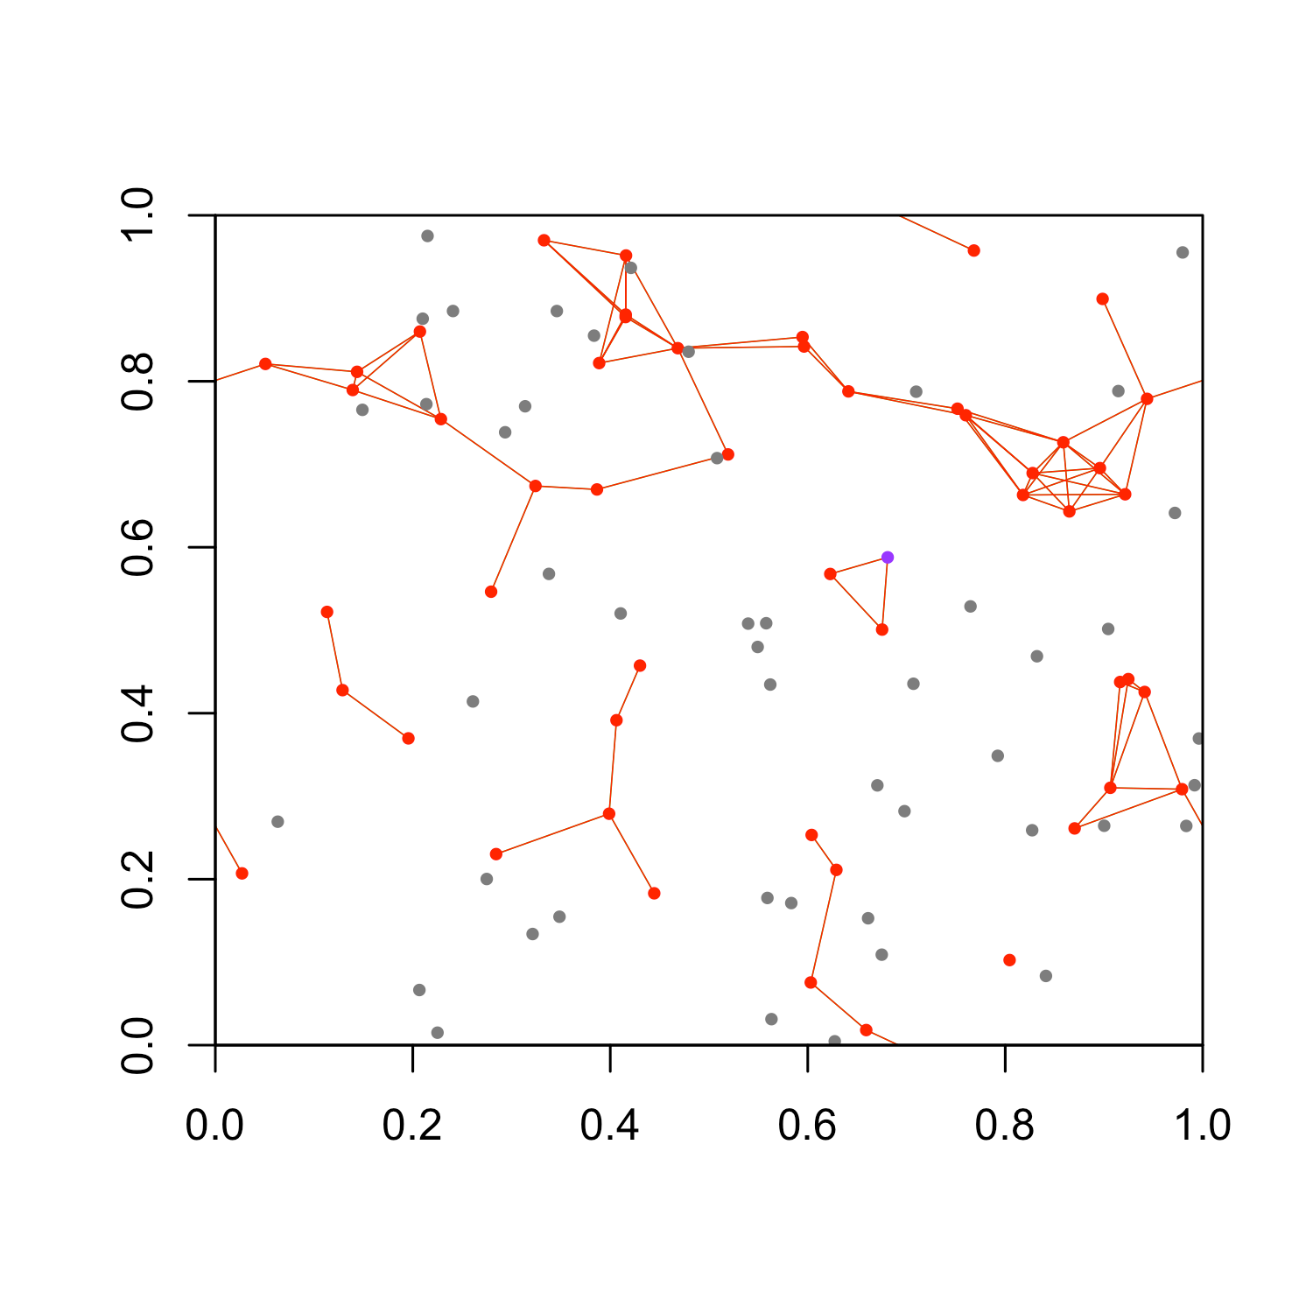
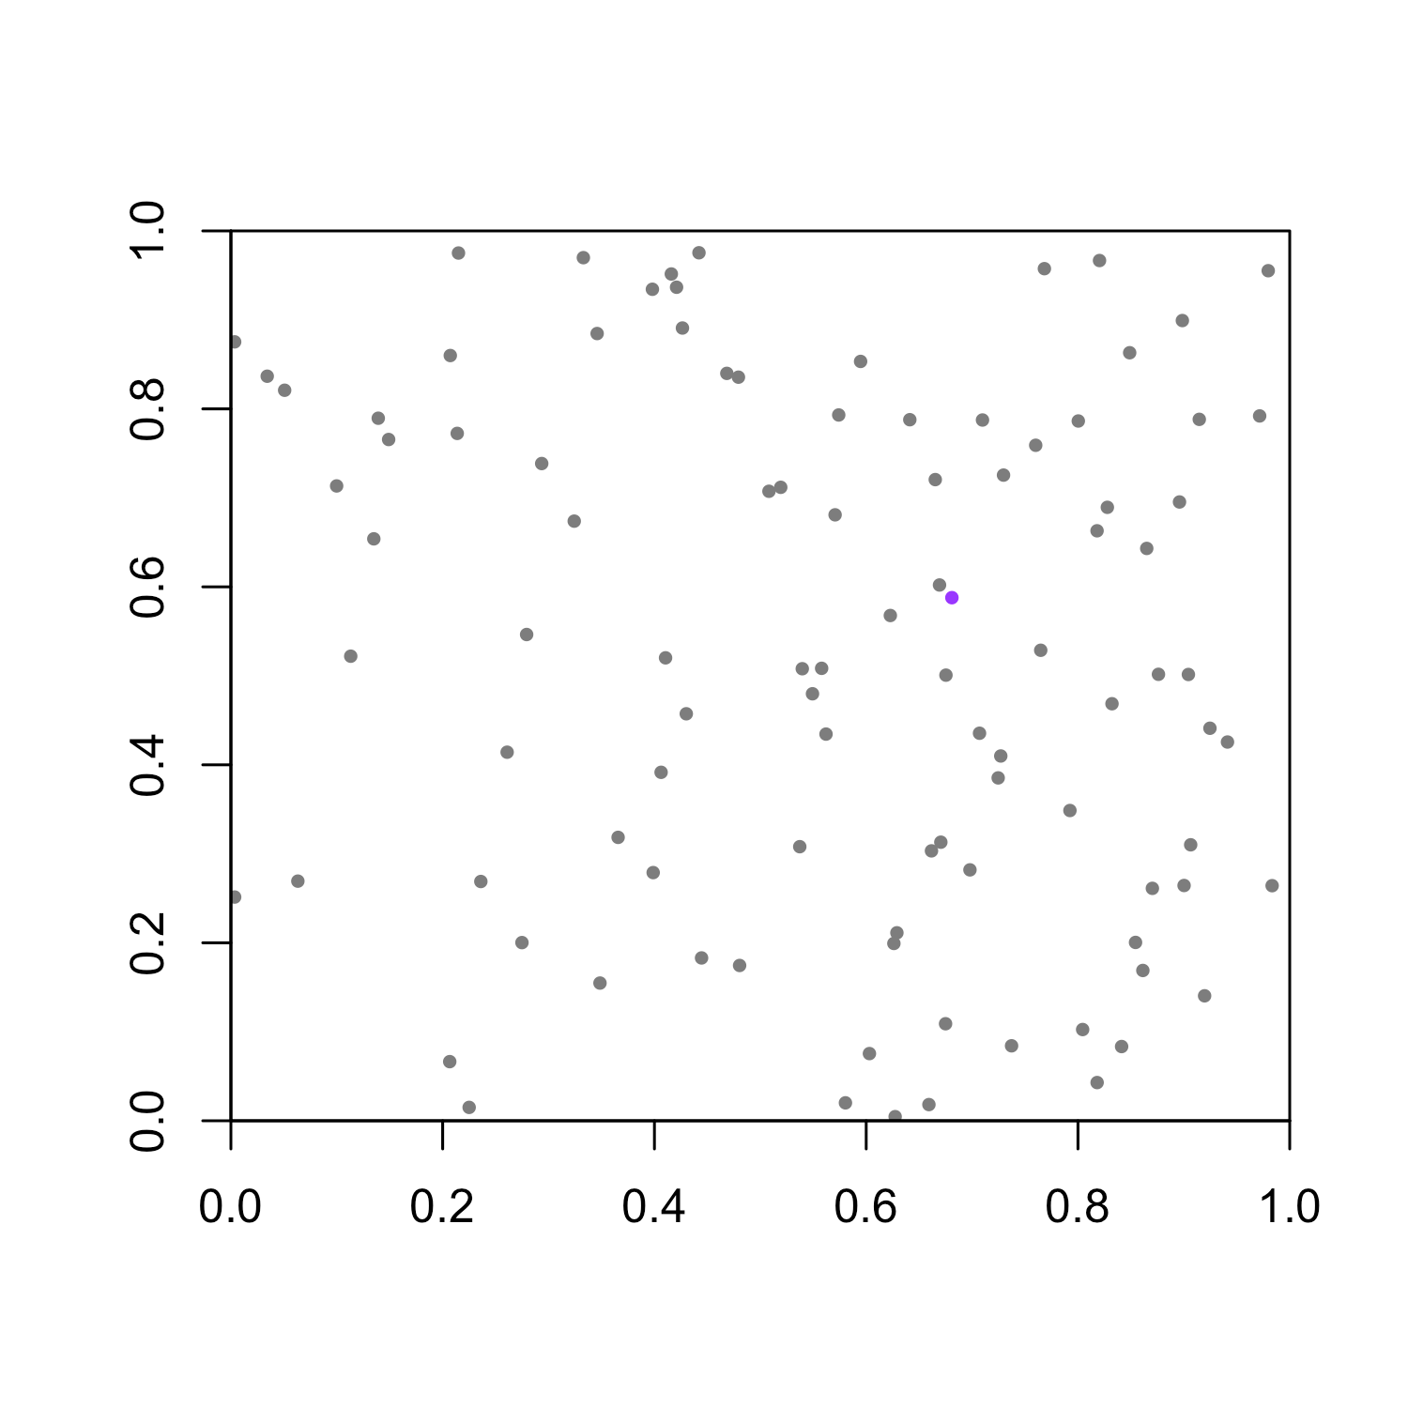
Transmission of Virus
times = 130: number of infectives reaches its peak with 63 infected devices.
times = 146: the last infective appears
times = 197: end of epidemic with a last survivor

Slide 14
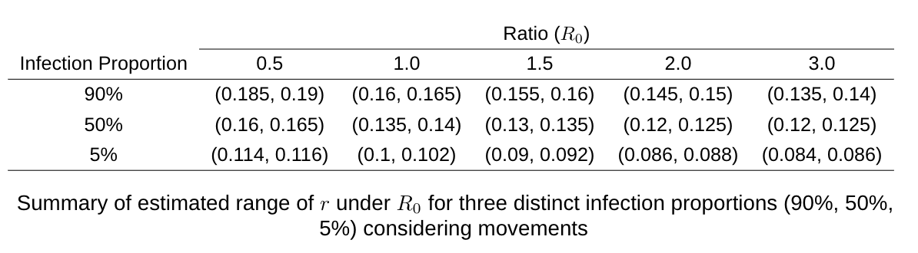
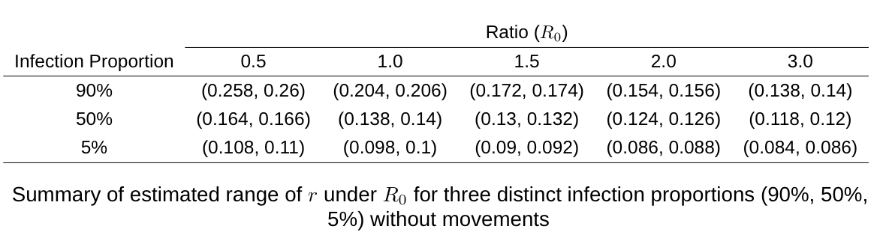
Summary of Results

Slide 15
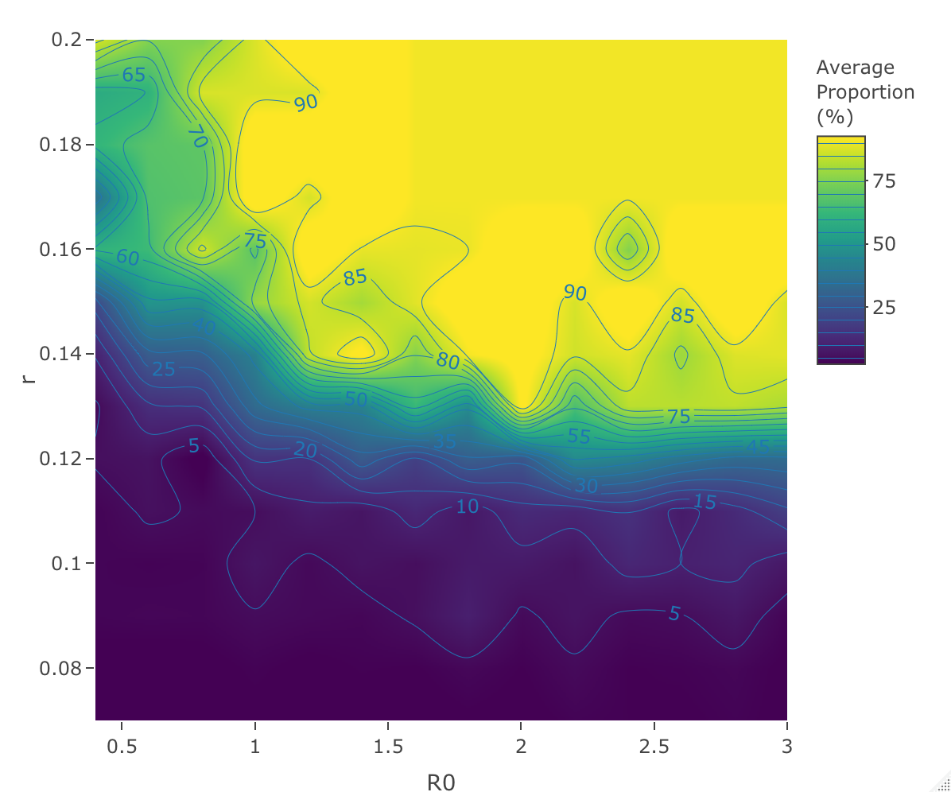
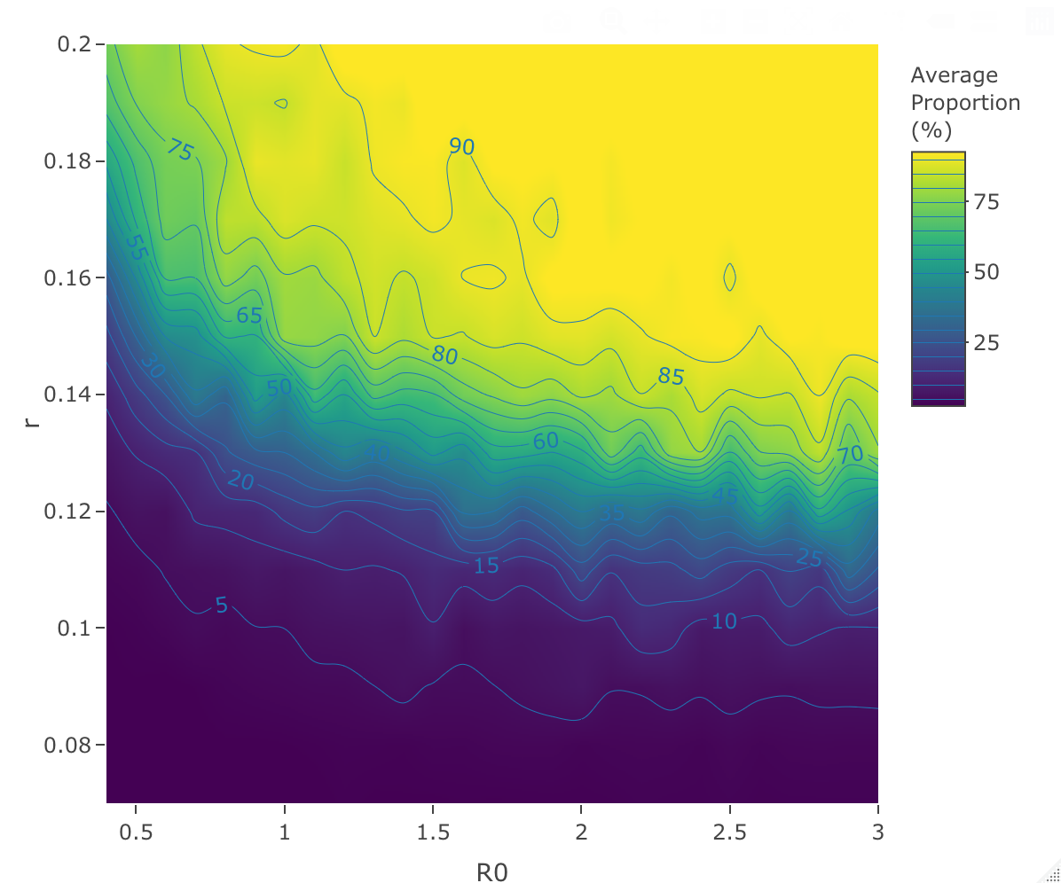
Summary of Results
Heatmap of average infection proportions considering movements
Heatmap of average infection proportions without movements

Slide 16
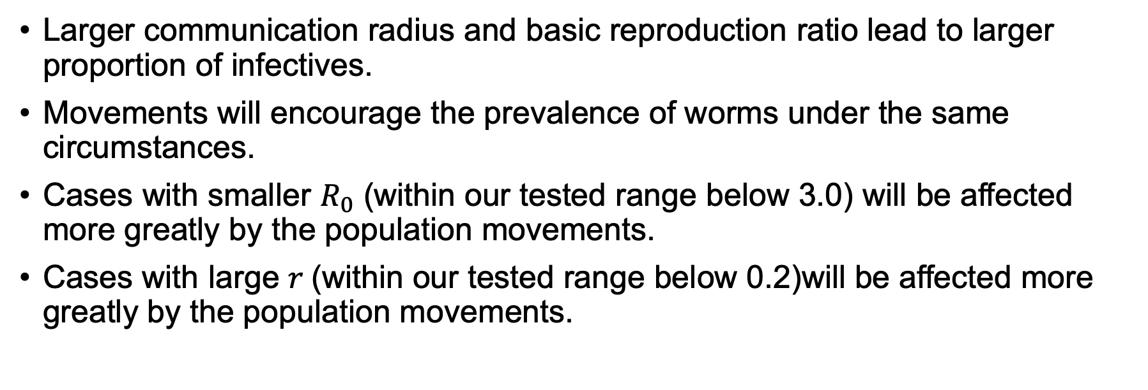
Conclusions
Larger communication radius and basic reproduction ratio lead to larger proportion of infectives.
Movements will encourage the prevalence of worms under the same circumstances.
Cases with smaller $R_{0}$ (within our tested range below 3.0) will be affected more greatly by the population movements.
Cases with large $r$(within our tested range below 0.2)will be affected more greatly by the population movements.

Slide 17
Limitations
Assumptions made do not reflect the real life.
Fixed time intervals for the movements of points between two events
identical transmission radius for every device
Relatively low efficiency
Check each pair of points near boundary when removing boundary
Check each pair of points when recalculating edges after event

Slide 18
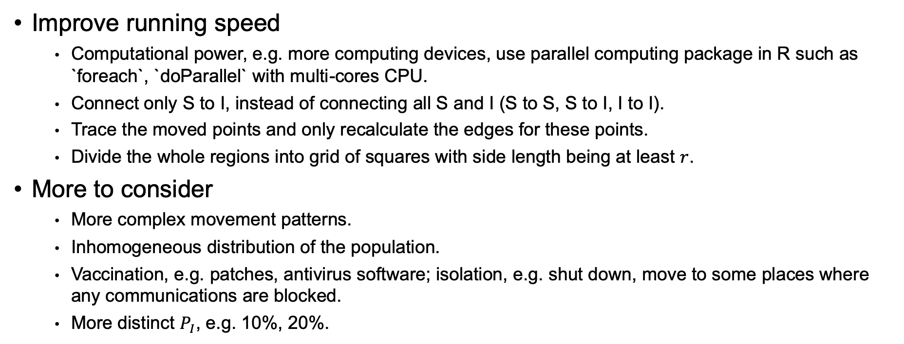
Further Work
Improve running speed
Computational power, e.g. more computing devices, use parallel computing package in R such as `foreach`, `doParallel` with multi-cores CPU.
Connect only S to I, instead of connecting all S and I (S to S, S to I, I to I).
Trace the moved points and only recalculate the edges for these points.
Divide the whole regions into grid of squares with side length being at least $r$.
More to consider
More complex movement patterns.
Inhomogeneous distribution of the population.
Vaccination, e.g. patches, antivirus software; isolation, e.g. shut down, move to some places where any communications are blocked.
More distinct $P_{I}$, e.g. 10%, 20%.

Slide 19
Thank you!

